Slide 1
IAC – MIDA2 project
16/09/2020, Milano
Alessio Russo
Carmelo Valore

Slide 2
Project‘s objective
The goal of the project is to create a car simulator running on Indianapolis Motor Speedway
The focus is to obtain relevant data that can be useful for the Indy Autonomous challenge
The different values used for the car model correspond to the real data of the car that will run the competition
Developed using Matlab/Simulink
2
Alessio Russo, Carmelo Valore
Notes:
Inserire qui gli slip

Slide 3
Project‘s structure
The three main points on which we focused during this project are:
Model of the car: a 3-DOF bicycle model has been used to represent the dynamics of the car with non-linear Pacejka tyre model
Controller: two different regulators designed with loop-shaping techniques able to make the vehicle follow a predefined trajectory with a given speed profile
Final results: from one lap to full race simulation to validate the model and to analyse data about tyre wear, fuel consumption and the effect of slipstreaming
3
Alessio Russo, Carmelo Valore
Notes:
Inserire qui gli slip

Slide 4
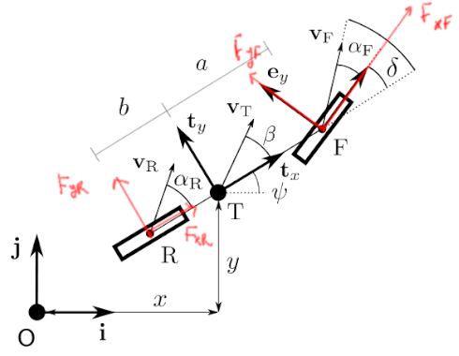
Dynamic bicycle model
Dynamic bicycle model
Pacejka tyre model
Aerodynamic forces
Fuel consumption model
Tyre wear model
Banking
Slipstream
4
Alessio Russo, Carmelo Valore
Notes:
Inserire qui gli slip

Slide 5
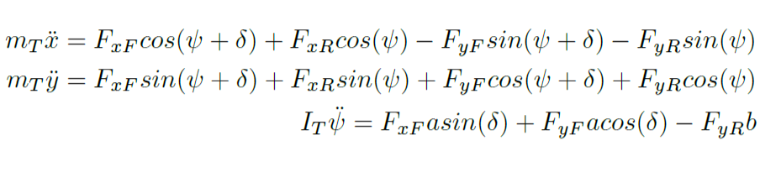
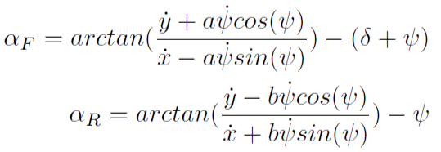
Dynamic bicycle model
Initial equations
Equilibrium with respect to the inertial frame Oij
5
Alessio Russo, Carmelo Valore
Notes:
Inserire qui gli slip

Slide 6
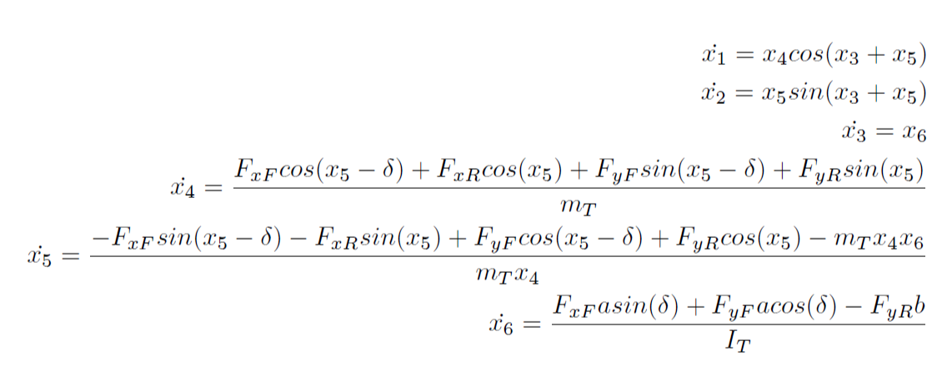
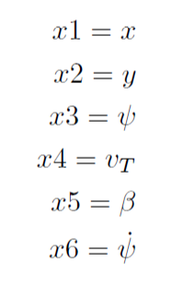
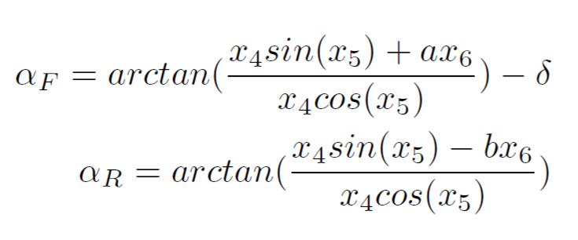
Dynamic bicycle model
We set the followings as the states of the model
So we derived the state equations
6
Alessio Russo, Carmelo Valore
Notes:
Inserire qui gli slip

Slide 7
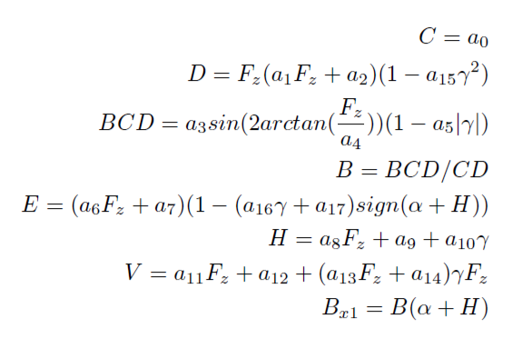
Pacejka tyre model
Pacejka formula derived
from experimental data
Takes as input:
the slip angle α
vertical load on the tyre F_{z}
the amplitude D
7
Alessio Russo, Carmelo Valore
Notes:
Inserire qui gli slip

Slide 8
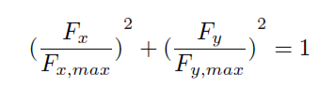
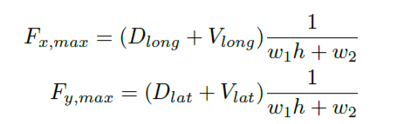
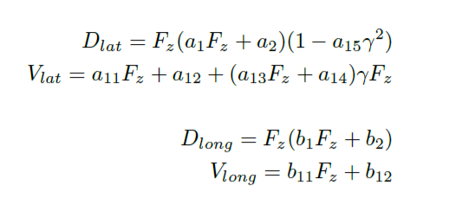
Friction ellipse (slide 1)
The physics of the tyre model is represented
through the friction ellipse
The ellipse dimension depends on:
the wear of the tyre h
the vertical load F_{z}
w₁ and w₂ that are parameters that regulate the scaling according to h
8
Alessio Russo, Carmelo Valore
Notes:
Inserire qui gli slip

Slide 9
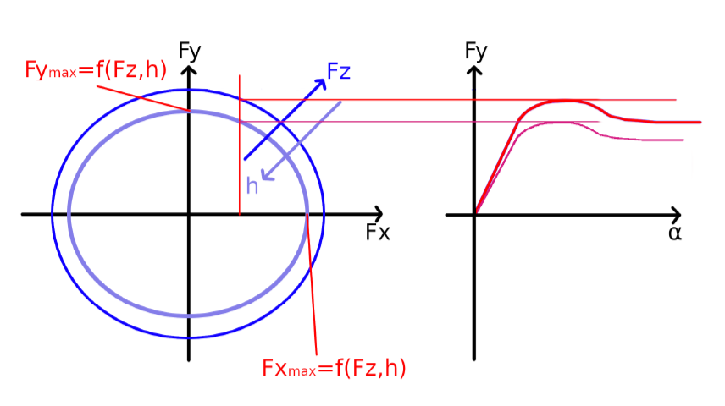
Friction ellipse (slide 2)
The control variable F_{x} determines F_{y} on the ellipse
The output of the Pacejka will be scaled according to F_{y}
We set the peak of the Pacejka (D_{lat} + V_{lat}) = F_{y}
9
Alessio Russo, Carmelo Valore
Notes:
Inserire qui gli slip

Slide 10
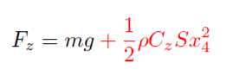
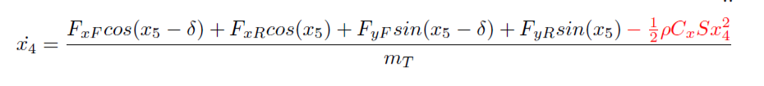
Aerodynamic forces
The drag force impacts on the body acceleration equation
Its contribution is negative because the applied force is opposite to the vehicle velocity
The contribution of the lift force increases the vertical load
Linear dependency with air density, drag/lift coefficient and area S of the considered surface. Square dependency with body velocity
10
Alessio Russo, Carmelo Valore
Notes:
Inserire qui gli slip

Slide 11
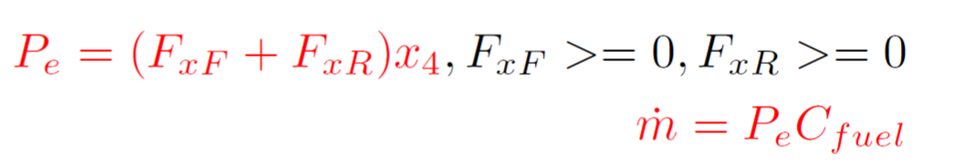
Fuel consumption model
Fuel consumption has been modelled by taking into account the power output
P = 0 while braking
P is multiplied by a C_{fuel} coefficient to express fuel consumption
11
Alessio Russo, Carmelo Valore
Notes:
Inserire qui gli slip

Slide 12
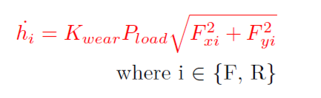
Tyre wear
Based on the Archard model for tyre wear
The model has been converted in order to take into account, instead of the sliding velocity, the forces acting on the wheels
So it depends on:
The vertical load pressure P_{load} = F_{z} / Tyre_contact_area
Forces F_{x} and F_{y} acting on the wheel
K_{wear} coefficient opportunely chosen
12
Alessio Russo, Carmelo Valore
Notes:
Inserire qui gli slip

Slide 13
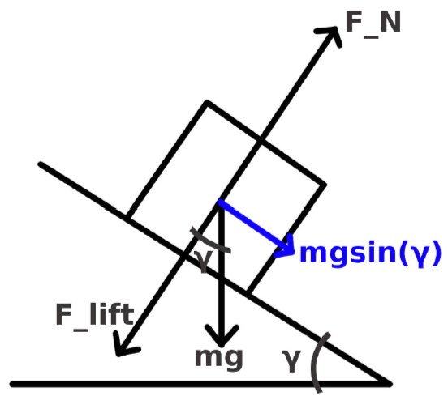
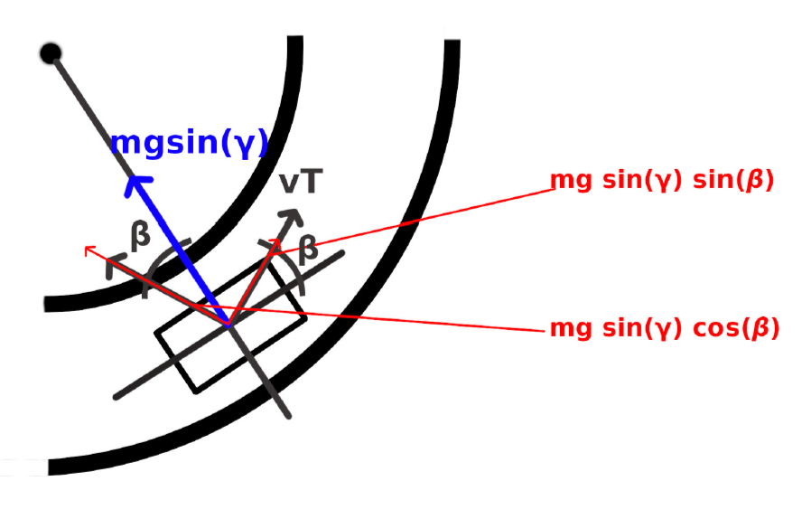
Banking (slide 1)
Banking has been considered in the model equations to take into acount the shape of Indianapolis circuit
To simplify the model, the car is assumed to always travel in parallel with respect to the tangent of the curve. In this way we only consider the projection of the weight force along the road surface
Lateral view
Top view
13
Alessio Russo, Carmelo Valore
Notes:
Inserire qui gli slip

Slide 14
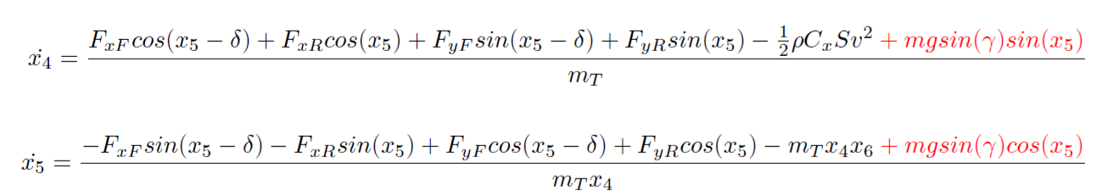
Banking (slide 2)
Given our assumptions, the projection mg*sin(γ) will
be directed to the center of the curve. Thus, we
projected it again to consider it into our state equations
14
Alessio Russo, Carmelo Valore
Notes:
Inserire qui gli slip

Slide 15
Slipstream
For slipstream different assumptions have been made to determine the change of aerodynamic coefficients
Different values considered if the vehicle is traversing straight paths or curvature paths
straight path: the drag force decrease is of 15% while the lift force decrease is of 30%
curvature path: the drag force decrease is of 15% while the lift force is left unchanged
15
Alessio Russo, Carmelo Valore
Notes:
Inserire qui gli slip

Slide 16
Validation of the model
The aspects analysed so far contribute to define our model
Some simulations have been run to test and validate it. The objective is to analyse the behaviour of the vehicle with the manouvers:
Non-accelerating straight path
Accelerating straight path
Accelerating straight path on a banked road
Accelerating-Braking straight path
Constant steer and incresing velocity path
Sinusoidal wave path
Constant speed and increasing steering angle
More details can be found in the PDF
16
Alessio Russo, Carmelo Valore
Notes:
Inserire qui gli slip

Slide 17
Control
To make the vehicle move according to a desired trajectory it is necessary to design a controller
We first need to linearize the model to design the controller on it
We choose as operating point for linearization a point where we assume that:
the vehicle is moving on a straight path
the vehicle has a constant longitudinal speed
17
Alessio Russo, Carmelo Valore

Slide 18
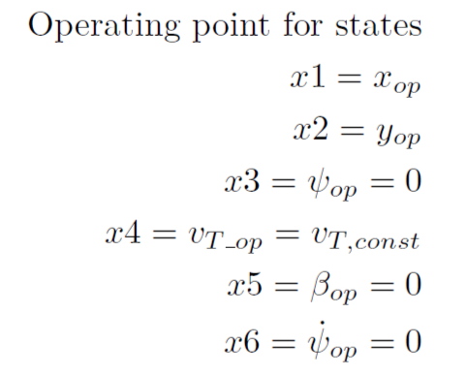
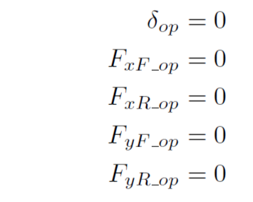
Linearized dynamic bicycle model
Non linear equations of the model
The values of states and inputs at the considered operating point are
18
Alessio Russo, Carmelo Valore
Notes:
Inserire qui gli slip

Slide 19
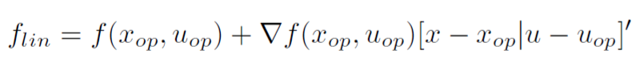
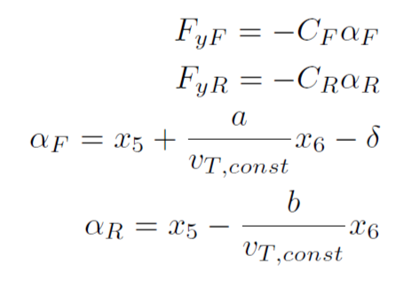
Control
Expanding the system in a Taylor series we have
Considering linear tyre model and linear version of the slip angles
19
Alessio Russo, Carmelo Valore

Slide 20
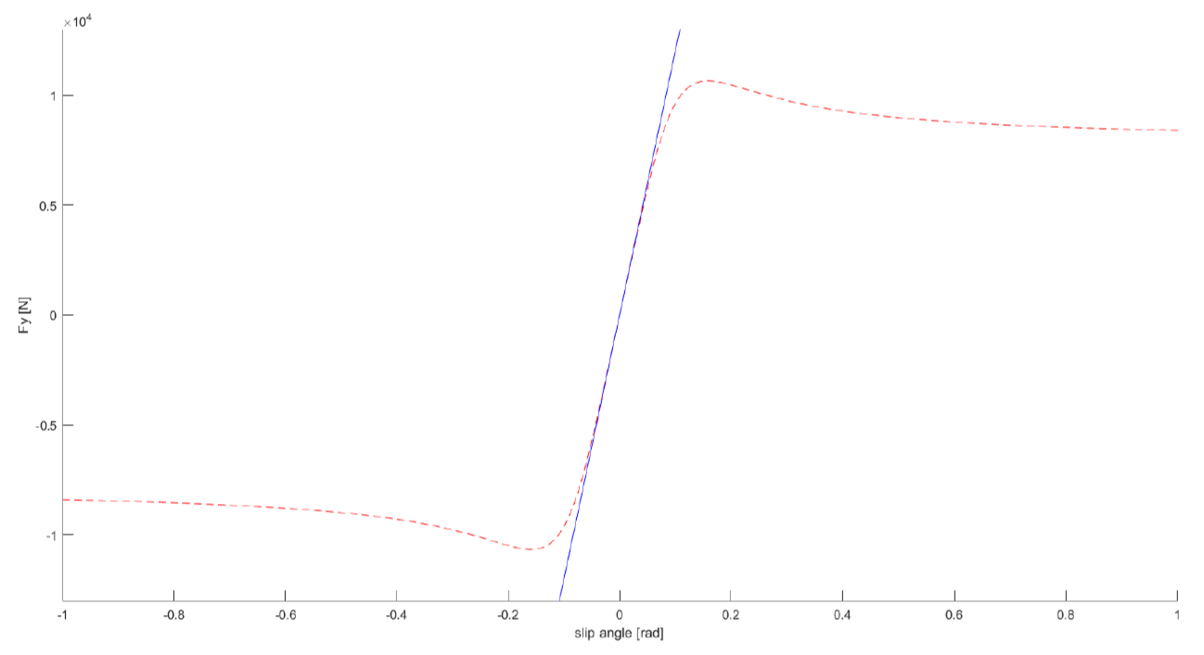
Control
The values for C_{F} and C_{R} have been chosen to best approximate the Pacejka tyre model in the case of small angles according to the mean vertical load on each wheel
20
Alessio Russo, Carmelo Valore

Slide 21
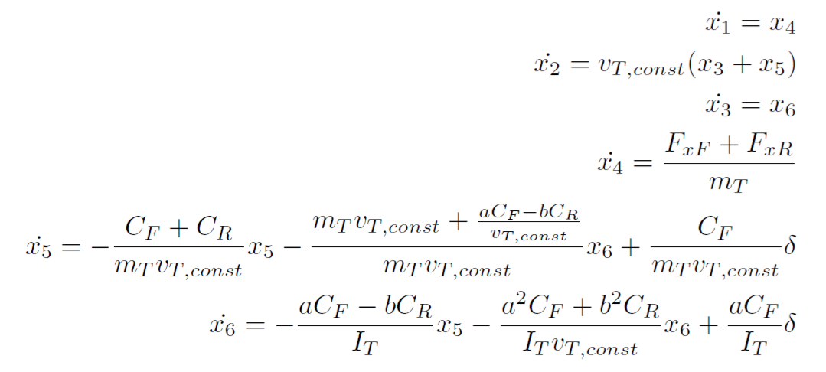
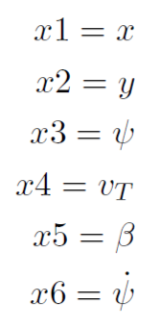
Control
So we obtain the linearized model
21
Alessio Russo, Carmelo Valore

Slide 22
Control
In our particular case it is possible to split the control logic into two independent controllers
Longitudinal controller: by controlling force on the rear wheel F_{xR} , it makes the vehicle follow a given velocity profile along the predefined trajectory
Lateral controller: by controlling the steering angle δ, it tries to minimize the lateral error with respect to a virtual point determined by the vehicle status and the lookahead distance
22
Alessio Russo, Carmelo Valore
Notes:
Inserire qui gli slip

Slide 23
Longitudinal control
The goal of the longitudinal controller is to make the vehicle follow a given speed profile
The speed profile is provided through an array of reference velocities indexed by the curvilinear abscissa
The reference velocity in a specific point of the track is found by looking up this array searching for the nearest point in the trajectory from the actual position of the vehicle
To design the regulator we used the transfer function from F_{xR} to v_{T} in the linearized model
23
Alessio Russo, Carmelo Valore

Slide 24
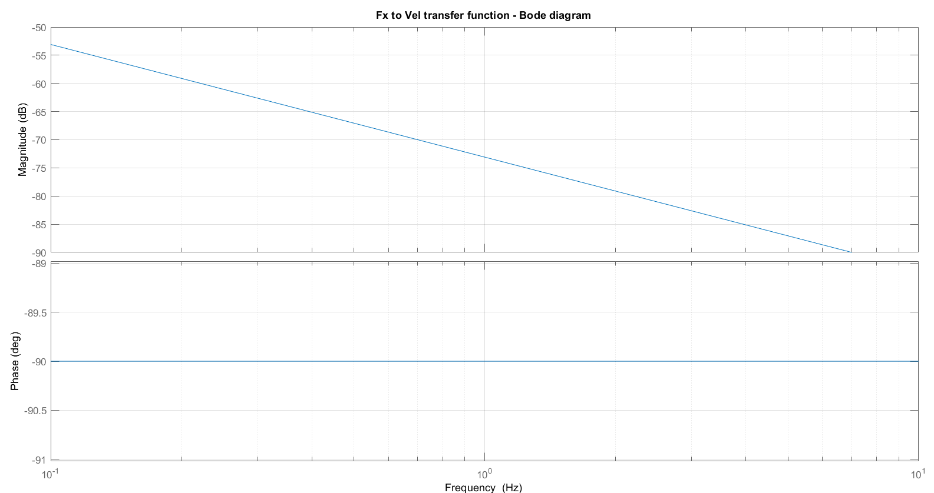
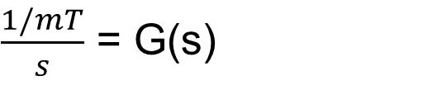
Longitudinal control
$\frac{1/mT}{s}$ = G(s)
Transfer function between F_{xR} and v_{T}:
24
Alessio Russo, Carmelo Valore

Slide 25
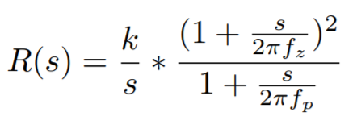
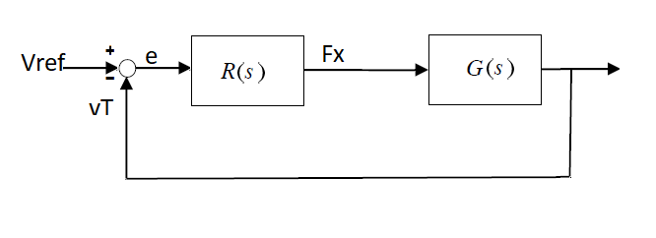
Longitudinal control
Regulator designed in order to have an open loop function that:
has a bandwidth of at least 1 [Hz]
rejects ramp disturbances
is stable when the loop is closed
25
Alessio Russo, Carmelo Valore

Slide 26
Longitudinal control
Tuned parameters are:
f_{z} = 0.06 [Hz]
f_{p} = 0.03 [Hz]
k = 5.2 x 10³
The double zeros were chosen to be coincident for tuning simplicity and were added to obtain a raise of the phase margin in order for the system to be stable. The pole at frequency f_{p} was added to obtain the desired bandwidth and to have a causal regulator.
26
Alessio Russo, Carmelo Valore

Slide 27
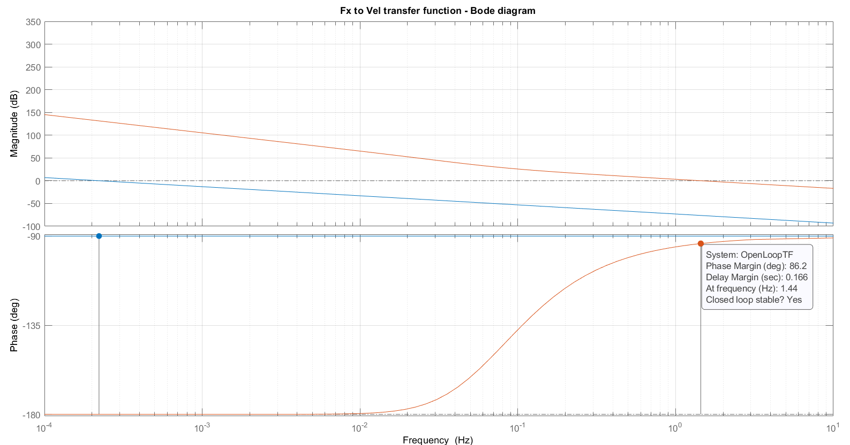
Bode plot of L(s) function
27
Alessio Russo, Carmelo Valore

Slide 28
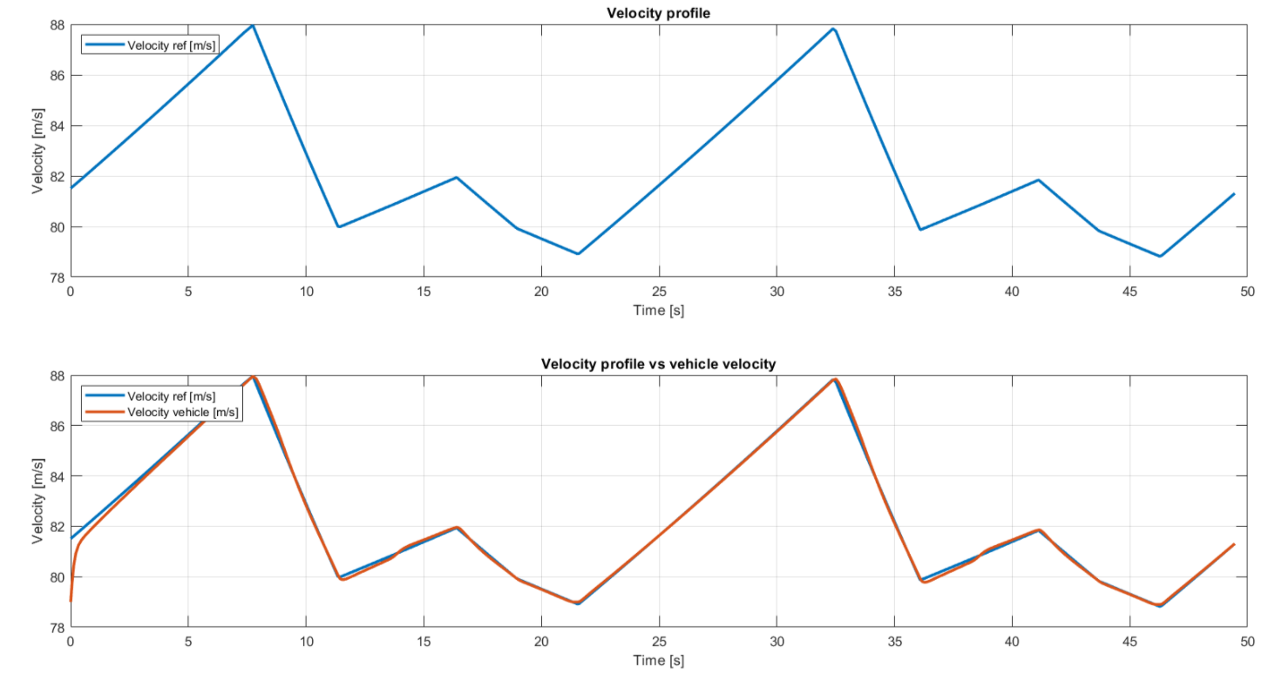
Longitudinal control - Tracking velocity results
28
Alessio Russo, Carmelo Valore

Slide 29
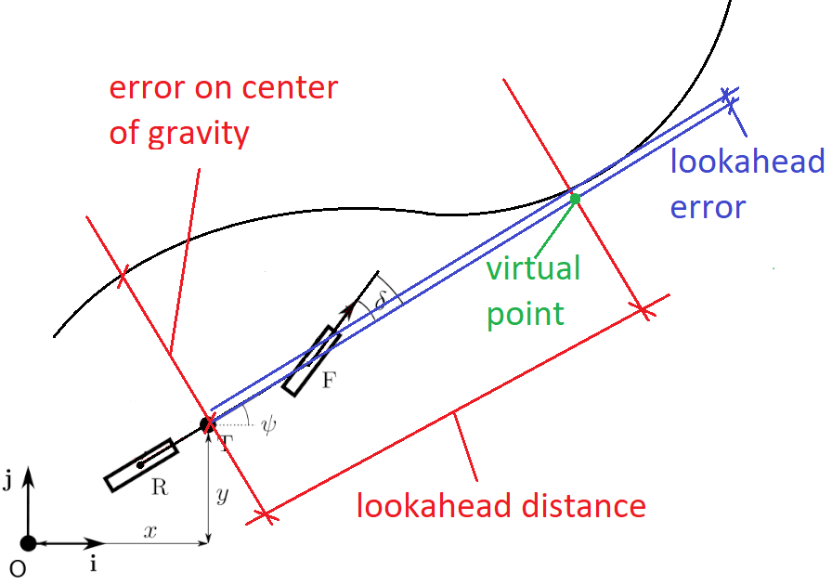
Lateral control
The goal of the lateral controller is to minimize the lateral error with respect to a virtual point determined by the vehicle’s position, vehicle’s heading direction and the lookahead distance
The idea behind the virtual point is
to foresee where the car will be in the
«next instants» and to steer
accordingly in order to have a better
path tracking
29
Alessio Russo, Carmelo Valore

Slide 30
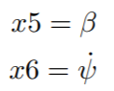
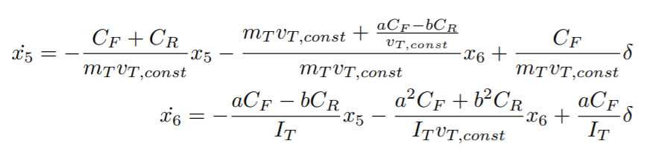
Lateral control
To build the lateral controller a slight modification in the considered state space model has been done
From the linearized model we first neglect the longitudinal dynamics and consider
30
Alessio Russo, Carmelo Valore

Slide 31
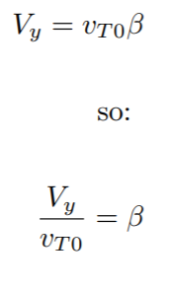
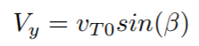
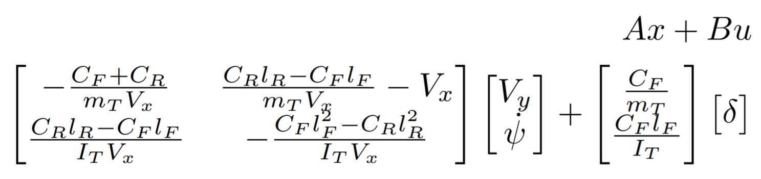
Lateral control
Then we make a change in the states by exploiting the following assumption that v_{T0} corresponds to V_{x} given that the vehicle is traversing a straight path and β is small
Thus obtaining
31
Alessio Russo, Carmelo Valore

Slide 32
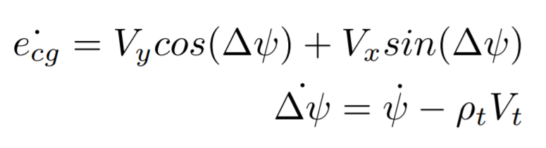
Lateral control
To this model two states and an input ρ (for the curvature) have been added to take into consideration the dynamic of the error
e_{cg} represents the lateral positioning error with respect to the center of gravity
∆ψ is the heading angle error, representing the difference between the desired yaw angle and the actual one
32
Alessio Russo, Carmelo Valore

Slide 33
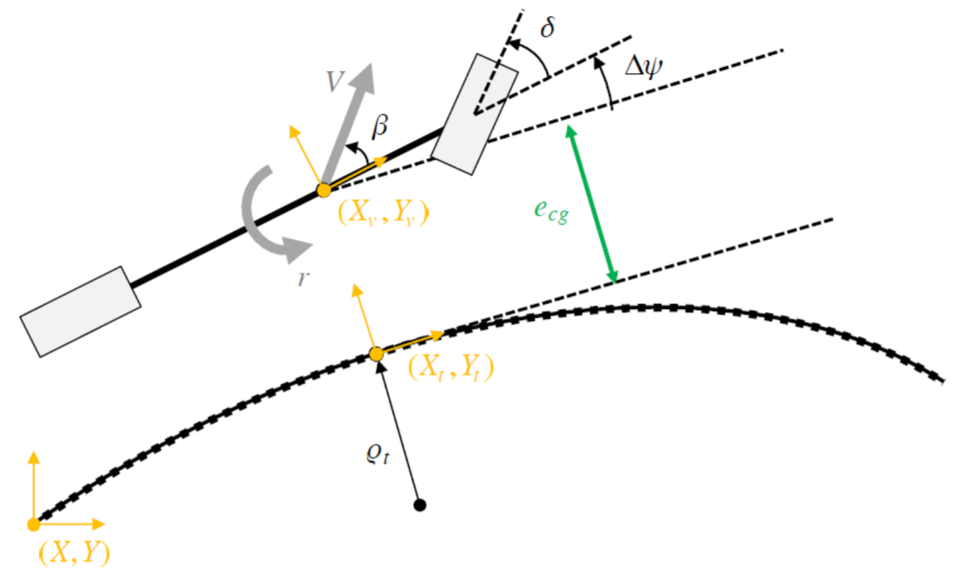
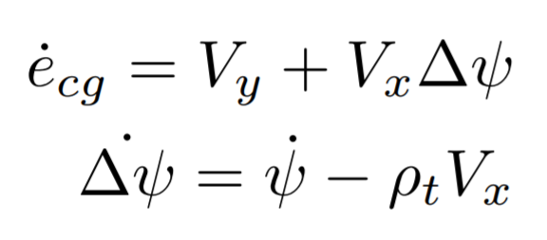
Lateral control
Using the small angle assumption and considering that the vehicle is well tracked we can also simplify
33
Alessio Russo, Carmelo Valore

Slide 34
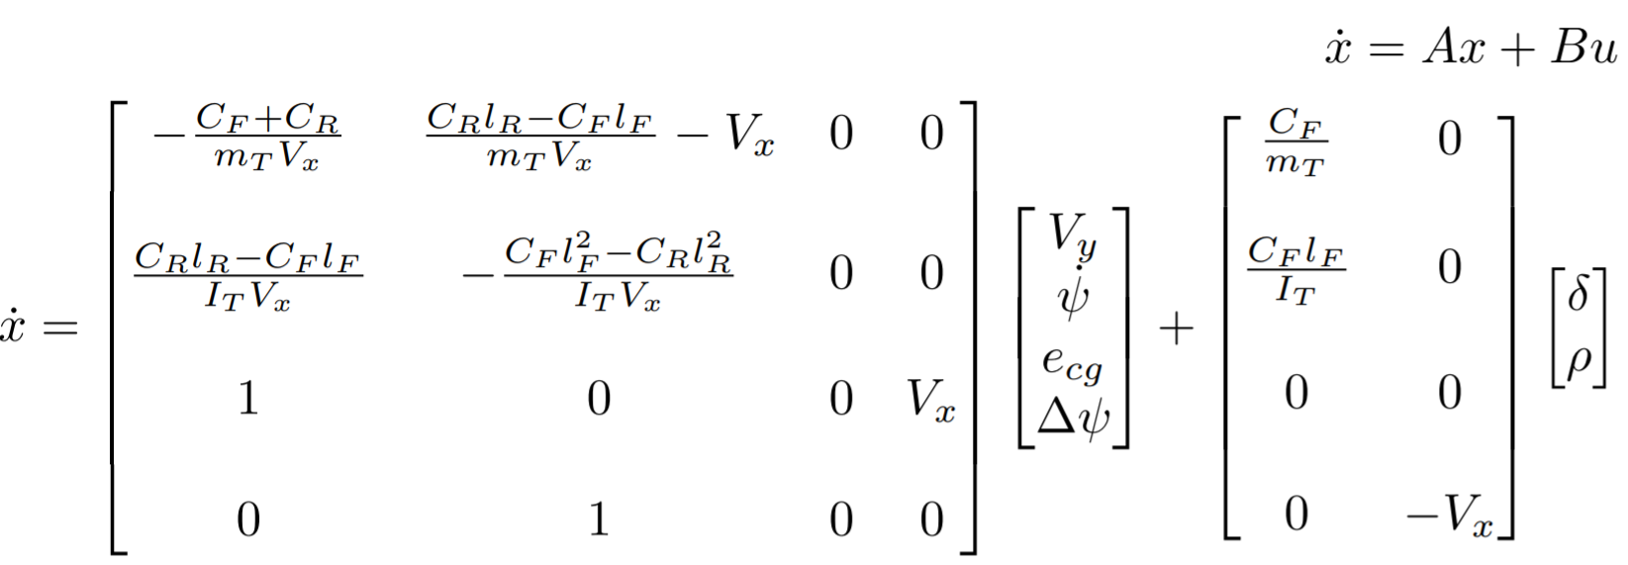
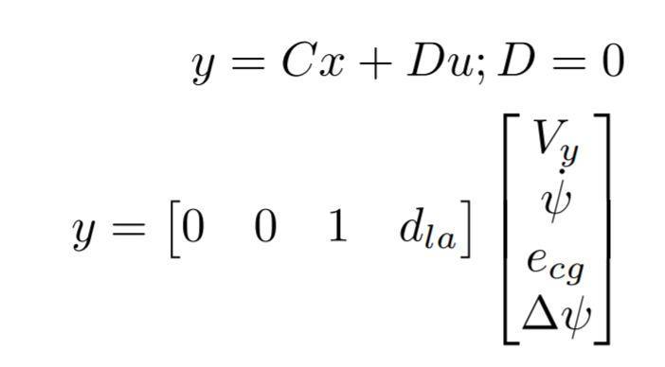
Lateral control
So we have the following state space model having as output the error on the lookahead e_{la} that will be the sum of e_{cg} and of the error determined by the lookahead distance d_{la}*∆ψ, where d_{la} = V_{x}/k
34
Alessio Russo, Carmelo Valore

Slide 35
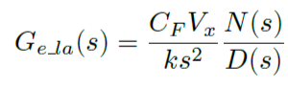
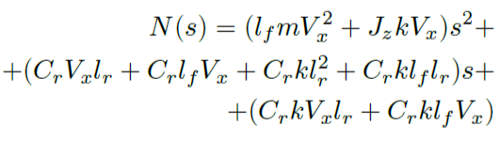
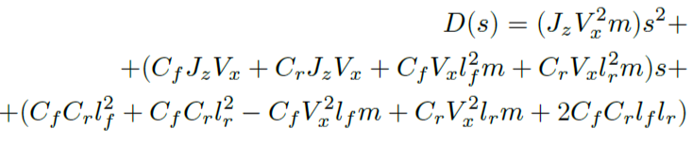
Lateral control
The transfer function obtained from the steering angle δ and the lateral error e_{la} error is
With N(s) and D(s):
35
Alessio Russo, Carmelo Valore

Slide 36
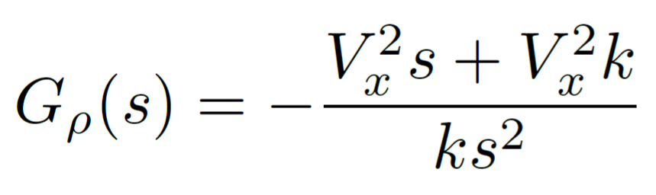
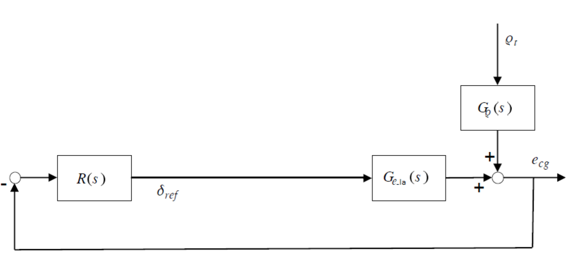
Lateral control
The transfer function obtained from the curvature ρ and the lateral error e_{la} error is
And the block diagram is:
36
Alessio Russo, Carmelo Valore

Slide 37
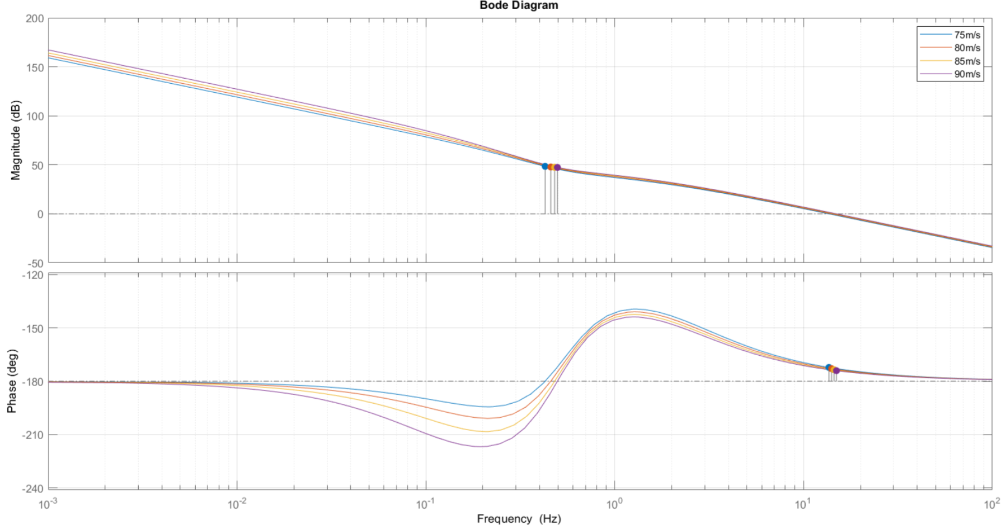
Bode plot of the plant G(s) at different velocities
37
Alessio Russo, Carmelo Valore

Slide 38
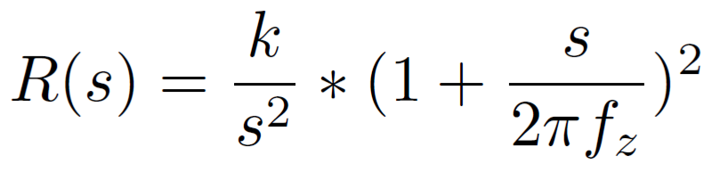
Lateral controller
Starting from the transfer function of the plant, the following regulator R(s) has been designed with tuned parameteres:
f_{z} = 0.01 [Hz]
k = 2*10⁻⁴
By combining R(s) and G(s) we obtain:
a closed-loop stable system
a system able to rejects step curvature disturbances
The second integrator has been added during the testing phase to overwhelm the non-linearity conditions
No need for rescheduling since bandwidth at different velocities is very similar
38
Alessio Russo, Carmelo Valore

Slide 39
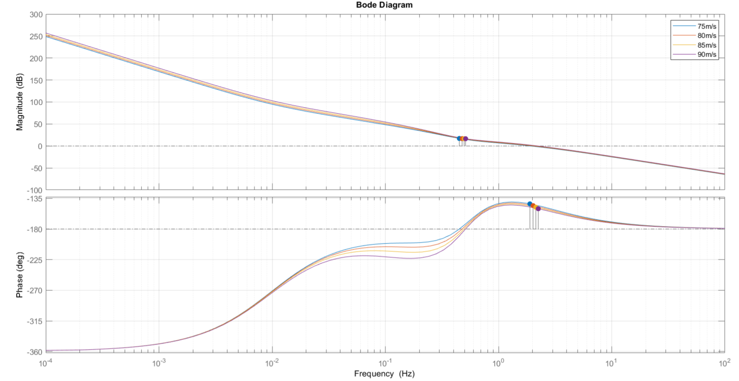
Bode diagram of L(s) at different velocities
39
Alessio Russo, Carmelo Valore

Slide 40

Step response of L(s) at different velocities
40
Alessio Russo, Carmelo Valore
Notes:
Senza lookahead con il regolatore di mori con gain cambiato a 0.01, le funzioni sono stabili ma ci sono oscillazioni forti già in partenza, senza feed-forward

Slide 41

Lateral controller
Lookahead varies instantly according to the velocity V_{x} scaled by a factor 1/k with k = 2
The feed-forward mechanism has been implemented
the value of the curvature referred to the current position of the vehicle is multiplied by the value C
41
Alessio Russo, Carmelo Valore

Slide 42

Lateral controller
Final block diagram
42
Alessio Russo, Carmelo Valore

Slide 43

Lap simulation
After the design phase of the two controllers, they have been tested with the original non-linear model and the results are shown in the following
43
Alessio Russo, Carmelo Valore

Slide 44

Lap simulation – speed profile tracking
44
Alessio Russo, Carmelo Valore

Slide 45

Lap simulation – Lateral error on center of gravity
45
Alessio Russo, Carmelo Valore

Slide 46

Lap simulation – Lateral error on lookahead
46
Alessio Russo, Carmelo Valore

Slide 47

Lap simulation – Controlled steering angle
47
Alessio Russo, Carmelo Valore

Slide 48
Lap simulations
After the definition of the model and of the two controllers some simulations have been run to evaluate the performances of the vehicle following the track with an high speed profile (around 80-85m/s). In particular:
A «stress test» has been performed on the vehicle considering two extreme conditions (slipstream-ON and slipstream-OFF) and a fixed velocity profile
A simulation run for an entire race (20 laps) using a different scaling factor for the speed profiles depending on the slipstream conditions (ON/OFF). The different scaling factors are chosen to push the vehicle to its limit being also able to achieve a good path tracking in both situations
A test has been executed to show how an error on the estimation of tyre wear impacts on the lap time
48
Alessio Russo, Carmelo Valore

Slide 49
Simulation results – Stress test
The goal of this test is to show how tyre wear can impact on the performances of the vehicle considering three different races:
The first with slipstream OFF
The second with slipstream ON
The third with slipstream OFF for the first 10 laps and slipstream ON for the last 10
Given speed profile is the same for all the simulations
When the lateral error of the vehicle is larger than a predefined threshold (2m), the simulation stops
49
Alessio Russo, Carmelo Valore

Slide 50
Simulation results – Stress test
The results clearly show a positive effect of slipstreaming. In particular:
The race with slipstream OFF terminates after 12 laps
The race with slipstream ON terminates after 15 laps
The race with both slisptream OFF and slisptream ON terminates after 14 laps
This is due to the fact that when slipstream is ON the drag and lift force decrease in modulus and this allows the vehicle to maintain a given velocity profile giving less force F_{xR} on the rear wheel. Thus the vehicle can run more laps in the second simulation
50
Alessio Russo, Carmelo Valore

Slide 51

Simulation results – Stress test, slipstreaming OFF, ellipse saturation
51
Alessio Russo, Carmelo Valore

Slide 52

Simulation results – Stress test, slipstreaming OFF, ellipse reduction
Ellipse reduction due to the wear - 14% less on rear tyre - 7% loss on front tyre
52
Alessio Russo, Carmelo Valore

Slide 53

Simulation results – Stress test, slipstreaming ON, ellipse saturation
53
Alessio Russo, Carmelo Valore

Slide 54

Simulation results – Stress test, slipstreaming ON, ellipse reduction
Ellipse reduction due to the wear - 16% less on rear tyre - 9% loss on front tyre
54
Alessio Russo, Carmelo Valore

Slide 55

Simulation results – Stress test, comparison between F_{xR} when slisptream ON/OFF
55
Alessio Russo, Carmelo Valore

Slide 56
Simulation results – simulation 2
The goal of this test is to simulate a more realistic scenario when the ego vehicle is «aware» of the tyre wear and also of the reduced force that can apply on the wheels in order to not lose control
The correlation between tyre wear and the reference velocity profile is handled by using a function that decreases the speed depending on the wear of the tyre
According to the situation in which the vehicle is (slipstream-ON or slipstream-OFF), two different constant values have been used to adjust the reference speed
The test is carried on running two entire races: the first with slipstream always OFF and the second with slipstream always OFF
56
Alessio Russo, Carmelo Valore

Slide 57
Simulation results – simulation 2
The following are the results of the two different simulations:
Slipstream OFF – 20 laps:
Race time: 1010.495 s -> 50.525 s/lap
Max speed on the first vs last lap: 88 m/s vs 84.2 m/s
Reduction of the maximum lateral force on the rear wheel at the end of the race: 24.05 %
Reduction of the maximum lateral force on the front wheel at the end of the race: 14.92 %
Fuel consumption: 57.91 kg consumed / 0.09 kg remaining
Slipstream ON – 20 giri:
Race time: 1001.475 s -> 50,074 s/lap
Max speed on the first vs last lap: 88 m/s -> 85.7 m/s
Reduction of the maximum lateral force on the rear wheel at the end of the race: 22.07 %
Reduction of the maximum lateral force on the front wheel at the end of the race: 13.82 %
Fuel consumption: 51.71 kg consumed / 6.29 kg remaining
57
Alessio Russo, Carmelo Valore

Slide 58
Simulation results – simulation 2
Analysing the obtained results we may see that:
Total race time is reduced by around 9 seconds, so an average of 0.5 seconds per lap that could be significant in a race
Peak velocity increases by the 2%, from 84.2 [m/s] to 85.7 [m/s], this is due to the fact that since tyres wear increasing is slower, higher velocities can be handled for more time
Maximum lateral forces reduction decreases by 2% on the rear wheel and by 1% on the front one.
Fuel consumption loss is significantly less, 0.09 [kg] of fuel remaining in the case of no-slipstreaming and 6.29 [kg] while slipstreaming, around 6 [kg] saved
58
Alessio Russo, Carmelo Valore

Slide 59

Simulation results – 20-laps test, slipstreaming OFF, velocity reduction
59
Alessio Russo, Carmelo Valore

Slide 60

Simulation results – 20-laps test, slipstreaming OFF, ellipse saturation
60
Alessio Russo, Carmelo Valore

Slide 61

Simulation results – 20-laps test, slipstreaming OFF, fuel consumption
61
Alessio Russo, Carmelo Valore

Slide 62

Simulation results – 20-laps test, slipstreaming ON, velocity reduction
62
Alessio Russo, Carmelo Valore

Slide 63

Simulation results – 20-laps test, slipstreaming ON, ellipse saturation
63
Alessio Russo, Carmelo Valore

Slide 64

Simulation results – 20-laps test, slipstreaming ON, fuel consumption
64
Alessio Russo, Carmelo Valore

Slide 65
Simulation results – tyre wear estimation error
To run this test some changes have been made by increasing and decreasing the tyre wear with the goal of obtaining a final loss on the friction ellipse respectively of around +5% and -5%
The objective is to show how an error of the estimation may impact on the final results (lap time, simulation time…)
While running these simulations a slightly different scaling in velocity has been applied to cope with tyre wear changes
65
Alessio Russo, Carmelo Valore

Slide 66
Simulation results – tyre wear estimation error
Simulation with loss higher by 5%
– Loss on rear ellipse 29%
– Race time 1029.7 [s]
– Lap time 51.485 [s]
• Reference simulation
– Loss on rear ellipse 24.5%
– Race time 1019.510 [s]
– Lap time 50.976 [s]
• Simulation with loss lower by 5%
– Loss on rear ellipse 20.2%
– Race time 1010.835 [s]
– Lap time 50.542 [s]
66
Alessio Russo, Carmelo Valore

Slide 67
Simulation results – tyre wear estimation error
From the results it can be seen that an error on estimation of tyre wear of around 5% has an impact of less than 1% on the lap time
We can conclude that having a small error on the estimation with respect to the real value may not be so critical
67
Alessio Russo, Carmelo Valore

Slide 68
IAC – MIDA2 project
68

